Slide 1
Constraint layout
Constraint Layout is a ViewGroup (i.e. a view that holds other views) which allows you to create large and complex layouts with a flat view hierarchy, and also allows you to position and size widgets in a very flexible way. It was created to help reduce the nesting of views and also improve the performance of layout files.

Slide 2
ConstraintLayout is very similar to RelativeLayout
It was released at Google I/O 2016. Since it came into existence (i.e. as at Android studio 2.3),
it has become a wildly used viewgroup and supports Android 2.3 or higher.

Slide 3
Advantages Of Constraint Layout Over Other Layouts
1. One great advantage of the constraint layout is that you can perform animations on your Constraint Layout views with very little code. 2. You can build your complete layout with simple drag-and-drop on the Android Studio design editor. 3. You can control what happens to a group of widgets through a single line of code. 4. Constraint Layout improve performance over other layout

Slide 4
Design Or Blueprint Mode In Android Studio:
In Android Studio design and blueprint mode are added which display the layout design in design and blueprint mode.
You can enable any mode or both together according to your requirement.

Slide 5
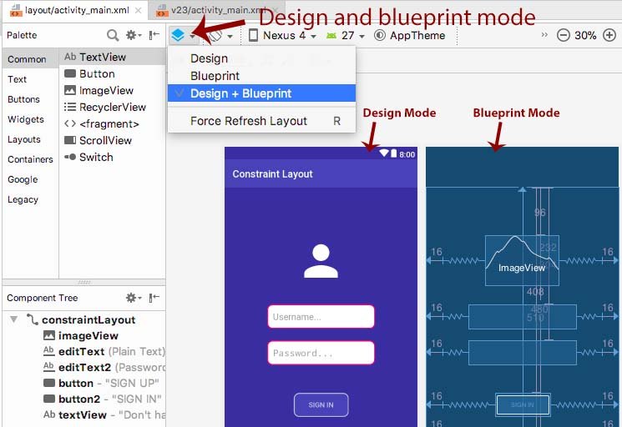

Slide 6
Lets suppose you drag a TextView element in Constraint Layout visual editor of Android Studio. Immediately after dragging you will notice a error with a message, “This view is not constrained…” So this simply means the view we created is not Constrained and we need to fix it. If we don’t fix it, the view won’t render properly when it will run in App.

Slide 7
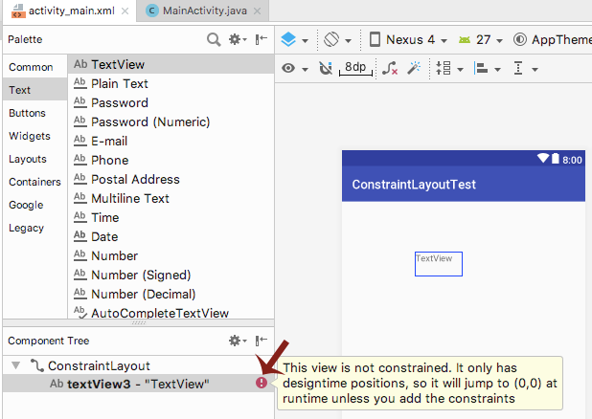

Slide 8
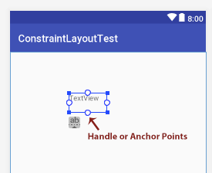
the button, you can see different points which can be called as handles or anchor points in Constraint Layout.
Click on the any handle and drag it to make connection with something else around it.

Slide 9
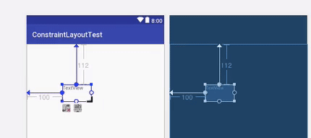
Resize handle – To resize the view size, you can use resize handle found at the corners which keeps constraint intact. Just simply drag and resize it according to your App UI requirements.

Slide 10

Side handle – The side handle are circular handle used to set the top, left, bottom and right constraints of the view.

Slide 11
Attribute Window For Constraint Layout:
On the right side you will notice a attribute window which share lots of details about the views that we used for View in Constraint Layout.
You control sizing of the element by clicking on 4 side arrows to change wrap_content to match_constrained, fixed size etc.
Bias decides view placement between its constraints on an axis. By default it is set 50% and can be changed easily by dragging.

Slide 12
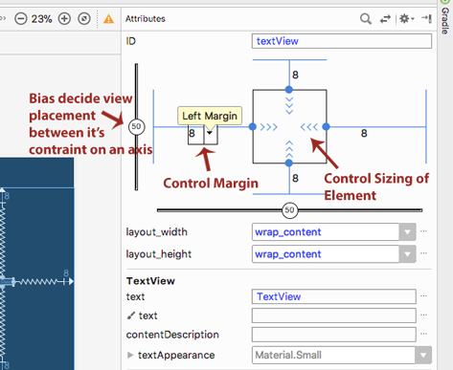

Slide 13
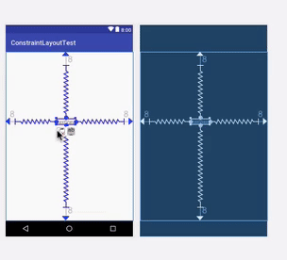
To delete the constrained connection, simply click on handle point and thats it.

Slide 14
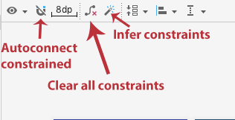
Different Tools In ConstraintLayout:
You can also use tools like Autoconnect to let Android Studio make automatic connection of view,
clear all constraints to delete all constraints in one go and infer constraint to automatic figure our the constraints for all the views on screen.

Slide 15
Text View
A Text View displays text to the user and optionally allows them to edit it.
A Text View is a complete text editor, however the basic class is configured to not allow editing.

Slide 16
Text View
r.No. | Attribute & Description
1 | android:id This is the ID which uniquely identifies the control.
2 | android:capitalize If set, specifies that this TextView has a textual input method and should automatically capitalize what the user types. Don't automatically capitalize anything - 0 Capitalize the first word of each sentence - 1 Capitalize the first letter of every word - 2 Capitalize every character - 3
3 | android:cursorVisible Makes the cursor visible (the default) or invisible. Default is false.
4 | android:editable If set to true, specifies that this TextView has an input method.
5 | android:fontFamily Font family (named by string) for the text.
6 | android:gravity Specifies how to align the text by the view's x- and/or y-axis when the text is smaller than the view.
7 | android:hint Hint text to display when the text is empty.

Slide 17
8 | android:inputType The type of data being placed in a text field. Phone, Date, Time, Number, Password etc.
9 | android:maxHeight Makes the TextView be at most this many pixels tall.
10 | android:maxWidth Makes the TextView be at most this many pixels wide.
11 | android:minHeight Makes the TextView be at least this many pixels tall.
12 | android:minWidth Makes the TextView be at least this many pixels wide.
13 | android:password Whether the characters of the field are displayed as password dots instead of themselves. Possible value either "true" or "false".

Slide 18
14 | android:phoneNumber If set, specifies that this TextView has a phone number input method. Possible value either "true" or "false".
15 | android:text Text to display.
16 | android:textAllCaps Present the text in ALL CAPS. Possible value either "true" or "false".
17 | android:textColor Text color. May be a color value, in the form of "#rgb", "#argb", "#rrggbb", or "#aarrggbb".
18 | android:textColorHighlight Color of the text selection highlight.
19 | android:textColorHint Color of the hint text. May be a color value, in the form of "#rgb", "#argb", "#rrggbb", or "#aarrggbb".
20 | android:textIsSelectable Indicates that the content of a non-editable text can be selected. Possible value either "true" or "false".
21 | android:textSize Size of the text. Recommended dimension type for text is "sp" for scaled-pixels (example: 15sp).

Slide 19
22 | android:textStyle Style (bold, italic, bolditalic) for the text. You can use or more of the following values separated by '|'. normal - 0 bold - 1 italic - 2
23 | android:typeface Typeface (normal, sans, serif, monospace) for the text. You can use or more of the following values separated by '|'. normal - 0 sans - 1 serif - 2 monospace - 3

Slide 20
This example will take you through simple steps to show how to create your own Android application using Linear Layout and TextView.
Step | Description
1 | You will use Android studio to create an Android application and name it as demo
2 | Modify src/MainActivity.java file to add necessary code .
3 | Modify the default content of res/layout/activity_main.xml file to include Android UI control.
4 | No need to change default string constants at string.xml file. Android studio takes care of default string constants.
5 | Run the application to launch Android emulator and verify the result of the changes done in the application.

Slide 21
Example

Slide 22
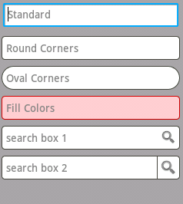
Edit Text
A EditText is an overlay over TextView that configures itself to be editable. It is the predefined subclass of TextView that includes rich editing capabilities.
Styles of edit text

Slide 23
EditText Attributes
Inherited from android.widget.TextView Class −
Sr.No | Attribute & Description
1 | android:autoText If set, specifies that this TextView has a textual input method and automatically corrects some common spelling errors.
2 | android:drawableBottom This is the drawable to be drawn below the text.
3 | android:drawableRight This is the drawable to be drawn to the right of the text.
4 | android:editable If set, specifies that this TextView has an input method.
5 | android:text This is the Text to display.

Slide 24
Inherited from android.view.View Class −
Sr.No | Attribute & Description
1 | android:background This is a drawable to use as the background.
2 | android:contentDescription This defines text that briefly describes content of the view.
3 | android:id This supplies an identifier name for this view.
4 | android:onClick This is the name of the method in this View's context to invoke when the view is clicked.
5 | android:visibilityThis controls the initial visibility of the view.

Slide 25
Example
Step | Description
1 | You will use Android studio IDE to create an Android application and name it as demo.
2 | Modify src/MainActivity.java file to add a click event.
3 | Modify the default content of res/layout/activity_main.xml file to include Android UI control.
4 | Define required necessary string constants in res/values/strings.xml file
5 | Run the application to launch Android emulator and verify the result of the changes done in the application.

Slide 26
Example

Slide 27
Image View
<LinearLayout xmlns:android="http://schemas.android.com/apk/res/android" android:layout_width="match_parent" android:layout_height="match_parent"> <ImageView android:layout_width="wrap_content" android:layout_height="wrap_content" android:src="@drawable/my_image" android:contentDescription="@string/my_image_description" /> </LinearLayout>

Slide 28
ImageView class is used to display any kind of image resource in the android application either it can be android.graphics.Bitmap or android.graphics.drawable.Drawable (it is a general abstraction for anything that can be drawn in Android). ImageView class or android.widget.ImageView inherits the android.view.
View class which is the subclass of Kotlin. Any class.
Application of ImageView is also in applying tints to an image in order to reuse a drawable resource and create overlays on background images.
Moreover, ImageView is also used to control the size and movement of an image.

Slide 29

Button
A button consists of text or an icon (or both text and an icon) that communicates what action occurs when the user touches it.
Depending on whether you want a button with text, an icon, or both, you can create the button in your layout in three ways:

Slide 30
Button Attributes
Following are the important attributes related to Button control.
Inherited from android.widget.TextView Class
Sr.No | Attribute & Description
1 | android:autoText If set, specifies that this TextView has a textual input method and automatically corrects some common spelling errors.
2 | android:drawableBottom This is the drawable to be drawn below the text.
3 | android:drawableRight This is the drawable to be drawn to the right of the text.
4 | android:editable If set, specifies that this TextView has an input method.
5 | android:text This is the Text to display.

Slide 31
Inherited from android.view.View Class −
Attribute | Description
1 | android: background This is a drawable to use as the background.
2 | android: contentDescription This defines text that briefly describes content of the view.
3 | android: id This supplies an identifier name for this view.
4 | android: onClick This is the name of the method in this View's context to invoke when the view is clicked.
5 | android: visibility This controls the initial visibility of the view.

Slide 32
Adding an ImageView to an activity
Whenever ImageView is added to an activity, it means there is a requirement for an image resource.
Thus it is oblivious to provide an Image file to that ImageView class.
It can be done by adding an image file that is present in the Android Studio itself or we can add our own image file.
Android Studio owns a wide range of drawable resources which are very common in the android application layout.
The following are the steps to add a drawable resource to the ImageView class.

Slide 33
Button
Android Button represents a push-button.
The android.widget.Button is subclass of TextView class and CompoundButton is the subclass of Button class.
There are different types of buttons in android such as RadioButton, ToggleButton, CompoundButton etc.

Slide 34
Text Button
With text, using the Button
class:
<Button android:layout_width="wrap_content" android:layout_height="wrap_content" android:text="@string/button_text" ... />

Slide 35
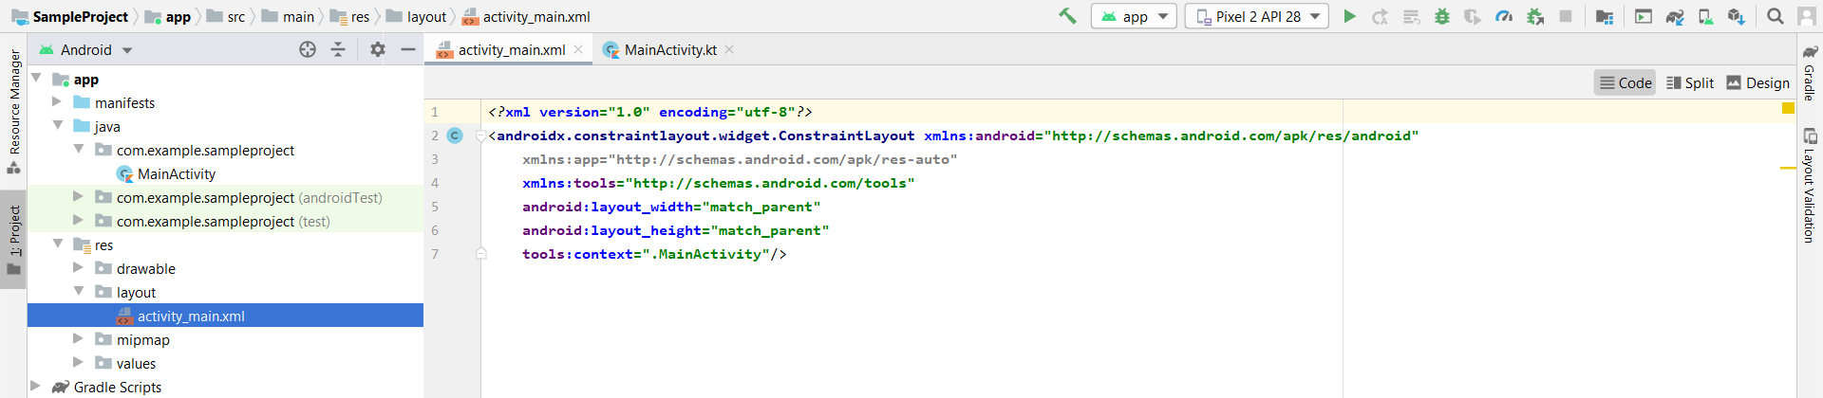
Open the activity_main.xml file in which the image is to be added

Slide 36
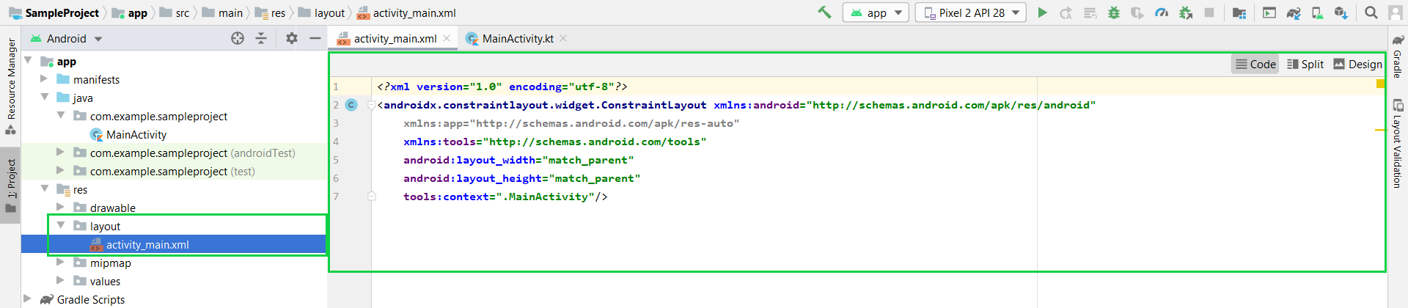

Slide 37
For adding an image from Android Studio Drag the ImageView widget to the activity area of the application, a pop-up dialogue box will open choose from the wide range of drawable resources and click “OK”.

Slide 38
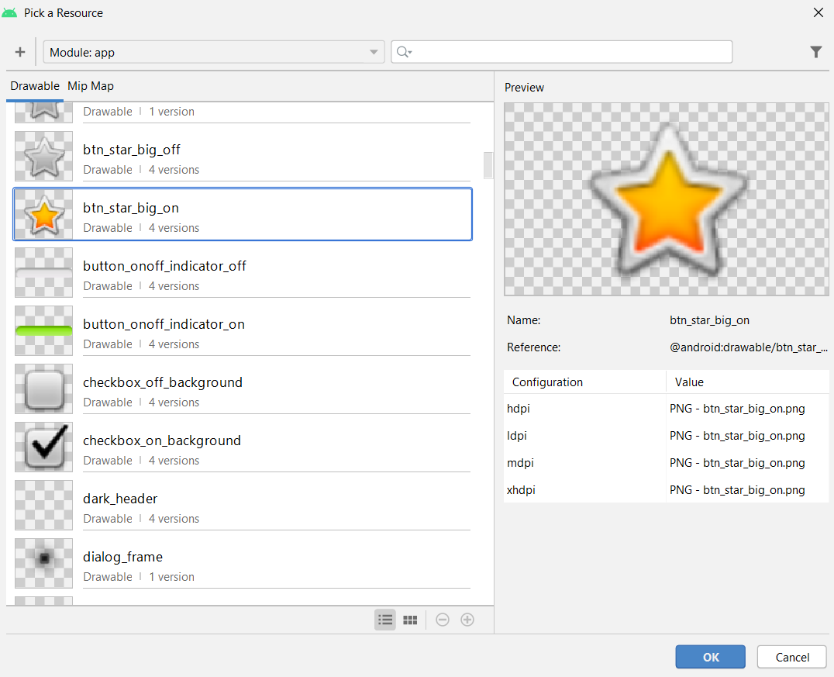

Slide 39
For adding an image file other than Android Studio drawable resources: Click on the “Resource Manager” tab on the leftmost panel and select the “Import Drawables” option.

Slide 40
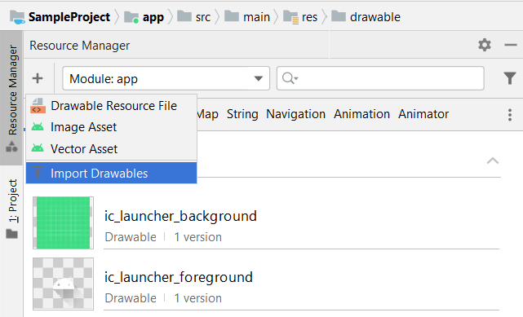

Slide 41
Select the path of the image file on your computer and click “OK”. After that set, the “Qualifier type” and “value” of the image file according to your need and click “Next” then “Import”.

Slide 42
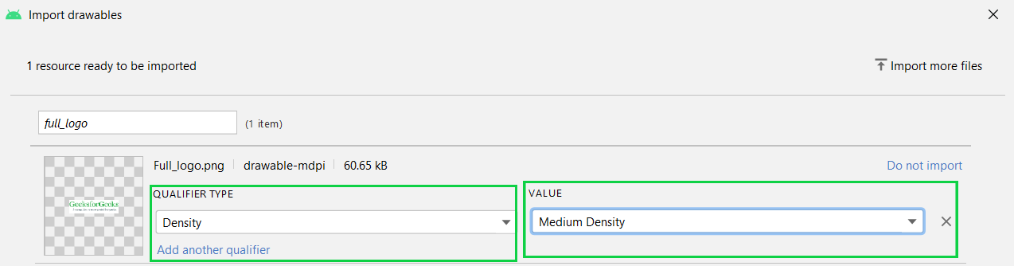

Slide 43
Drag the ImageView class in the activity area, a pop-up dialogue box will appear which contain your imported image file. Choose your image file and click “OK”, your image will be added to the activity.

Slide 44
XML Attributes of ImageView
XML Attribute
Description
android:id To uniquely identify an image view
android:src/app:srcCompat To add the file path of the inserted image
android:background To provide a background color to the inserted image
android:layout_width To set the width of the image
android:layout_height To set the height of the image
android:padding To add padding to the image from left, right, top, or bottom of the view
android:scaleType To re-size the image or to move it in order to fix its size

